Slide 1
Intro to Javascript

Slide 2
What is Javascript?
a lightweight programming language ("scripting language")
used to make web pages interactive
insert dynamic text into HTML
react to events (ex: page load user click)
perform calculations on user's computer (ex: form validation)
NOT related to Java other than by name and some syntactic similarities

Slide 3
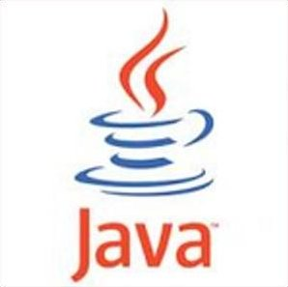
Javascript vs Java
interpreted, not compiled
more relaxed syntax and rules
fewer and "looser" data types
variables don't need to be declared
errors often silent (few exceptions) contained within a web page and integrates with its HTML/CSS content…

Slide 4
Linking to a JavaScript file: script
<script src="filename" type="text/javascript"></script> HTML
script tag should be placed in HTML page's head
script code is stored in a separate .js file
JS code can be placed directly in the HTML file's body or head (like CSS)
but this is bad style (should separate content, presentation, and behavior

Slide 5
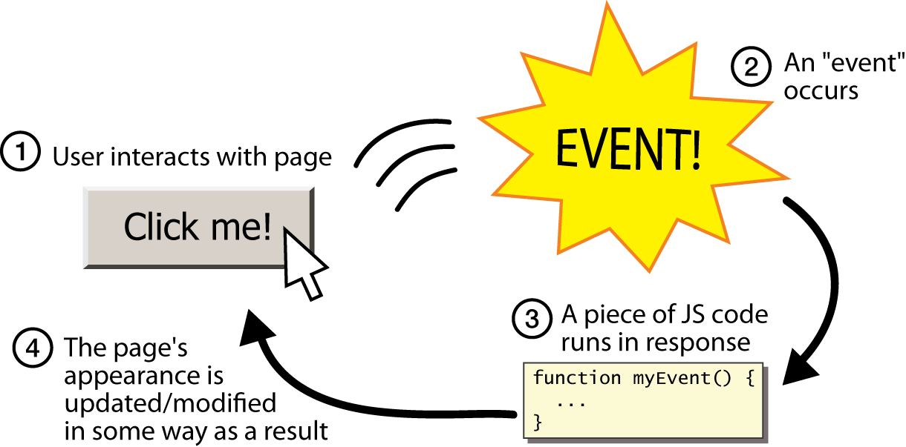
Event-driven programming
split breaks apart a string into an array using a delimiter
can also be used with regular expressions (seen later)
join merges an array into a single string, placing a delimiter between them

Slide 6
Event-driven programming
JavaScript programs instead wait for user actions called events and respond to them
event-driven programming: writing programs driven by user events
Let's write a page with a clickable button that pops up a “Some Text" window...
Let's Go

Slide 7
Event handlers
<element attributes onclick="function();">... HTML
<button onclick="myFunction();">Click me!</button> HTML
JavaScript functions can be set as event handlers
when you interact with the element, the function will execute
onclick is just one of many event HTML attributes we'll use
but popping up an alert window is disruptive and annoying
A better user experience would be to have the message appear on the page...

Slide 8
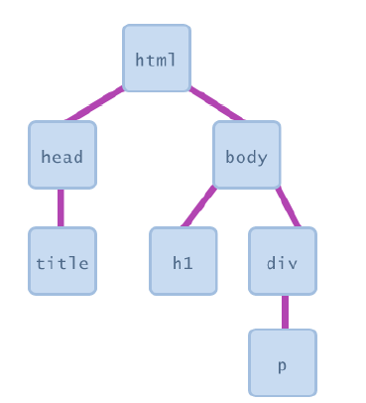
Document Object Model (DOM)
most JS code manipulates elements on an HTML page
we can examine elements' state
e.g. see whether a box is checked
we can change state
e.g. insert some new text into a div
we can change styles
e.g. make a paragraph red

Slide 9
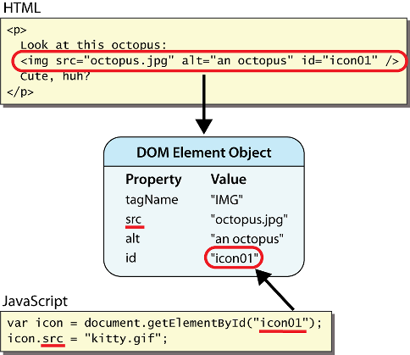
DOM element objects
Notes:
every element on the page has a corresponding DOM object access/modify the attributes of the DOM object with objectName.attributeName

Slide 10
Accessing elements: document.getElementById
document.getElementById returns the DOM object for an element with a given id
can change the text inside most elements by setting the innerHTML property
can change the text in form controls by setting the value property

Slide 11
Changing element style: element.style
Attribute | Property or style object
color | color
padding | padding
background-color | backgroundColor
border-top-width | borderTopWidth
Font size | fontSize
Font famiy | fontFamily

Slide 12
Preetify
function changeText() {
//grab or initialize text here
// font styles added by JS:
text.style.fontSize = "13pt";
text.style.fontFamily = "Comic Sans MS";
text.style.color = "red"; // or pink?
} JS

Slide 13
Variables
var name = expression; JS
var clientName = "Connie Client";
var age = 32;
var weight = 127.4; JS
variables are declared with the var keyword (case sensitive)
types are not specified, but JS does have types ("loosely typed")
Number, Boolean, String, Array, Object, Function, Null, Undefined
can find out a variable's type by calling typeof

Slide 14
JavaScript functions
function name() {
statement ;
statement ;
...
statement ;
} JS
function myFunction() {
alert("Hello!");
alert("How are you?");
} JS
the above could be the contents of example.js linked to our HTML page
statements placed into functions can be evaluated in response to user events

Slide 15
Comments (same as Java)
// single-line comment
/* multi-line comment */ JS
identical to Java's comment syntax
recall: 4 comment syntaxes
HTML: <!-- comment -->
CSS/JS/PHP: /* comment */
Java/JS/PHP: // comment
PHP: # comment

Slide 16
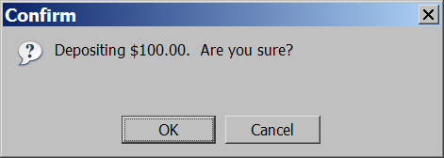
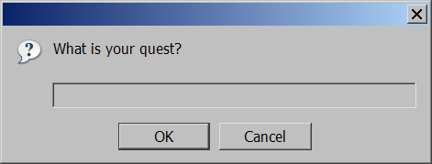
Popup boxes
alert("message"); // message
confirm("message"); // returns true or false
prompt("message"); // returns user input string JS

